Slide 1
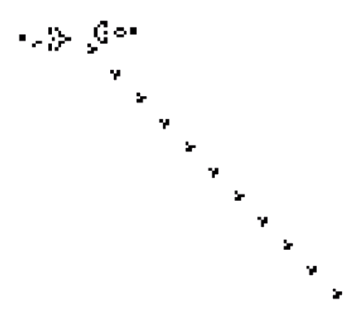
The Game Of Life
The CDM-16 project made by Anna Shemchuk & Egor Dashkovsky, 24216.

Slide 2
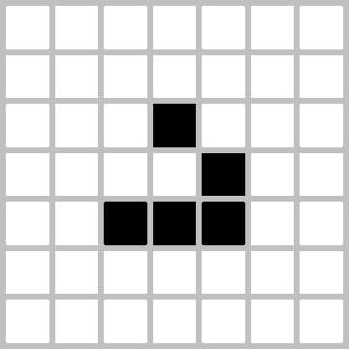
Standard rules
1. Living cells nearby are neighbours
2. 3 neighbours - a dead cell comes to life
3. 2, 3 neighbours – a living cell continues to live
4. Other cases lead to death

Slide 3




Software

Slide 4
4 stages of software implementation
Naive implementation
Encoding a cell in 4 bits + Lookup Table (LUT)
Boolean function instead of LUT
Packing four cells into a uint16_t (two-byte words)

Slide 5
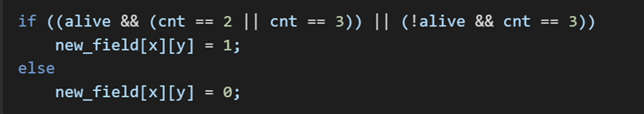
1. Naive realization
The field is represented as a two-dimensional array uint8_t field[16][16].
The state of each cell is stored as 0 (dead) or 1 (alive).
A nested loop over the X and Y axes is used to iterate over all 256 cells.
For each cell:
The number of live neighbours is counted by checking the eight surrounding elements of the array.
The following condition is checked:
The result is written using double buffering.
Condition:

Slide 6
2.1 Encoding a cell in 4 bits + Lookup Table (LUT)
Cell
0bvsss, where
v - stores whether the cell is alive or dead,
sss - is the number of neighbours
8 (0b1000) or 0 (0b0000) neighbours will be dead in the next generation.

Slide 7
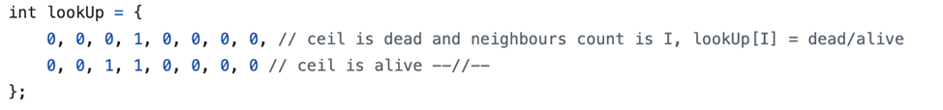
2.2 Lookup Table (LUT)
0b_0000
0b_0001
0b_0010
0b_0011
0b_0100
0b_0101
0b_0110
0b_0111
0b_1000
0b_1001
0b_1010
0b_1011
0b_1100
0b_1101
0b_1110
0b_1111
abcd
| 0
| 0
| 0
| 1
| 0
| 0
| 0
| 0
| 0
| 0
| 1
| 1
| 0
| 0
| 0
| 0

Slide 8
3. Boolean Function Instead of LUT
PDNF function for LUT: (0b_abcd: 0b_0011 | 0b_1010 | 0b_1011)
f(a, b, c, d) = (¬a ∧ ¬b ∧ c ∧ d) ∨ (a ∧ ¬b ∧ c ∧ ¬d) ∨ (a ∧ ¬b ∧ c ∧ d)
Boolean Function Minimization:
f(a, b, c, d) = ¬b ∧ c ∧ (d ∨ a)
Code implementation: (conclusion.c)

Slide 9
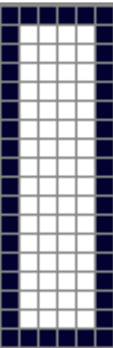
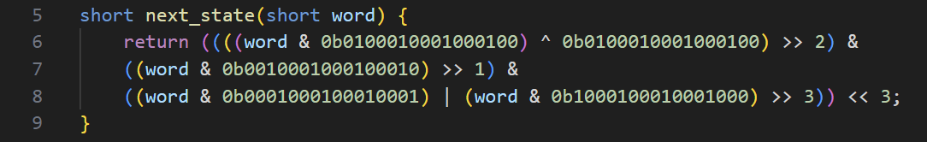
Packing Four Cells into uint16_t (Two-Byte Words)
Encoding of four cells:
Field:
Each 16-bit word packs four 4-bit cells of the form 0b_vsss_vsss_vsss_vsss
Function modification for 4 cells:
(conclusion.c)

Slide 10
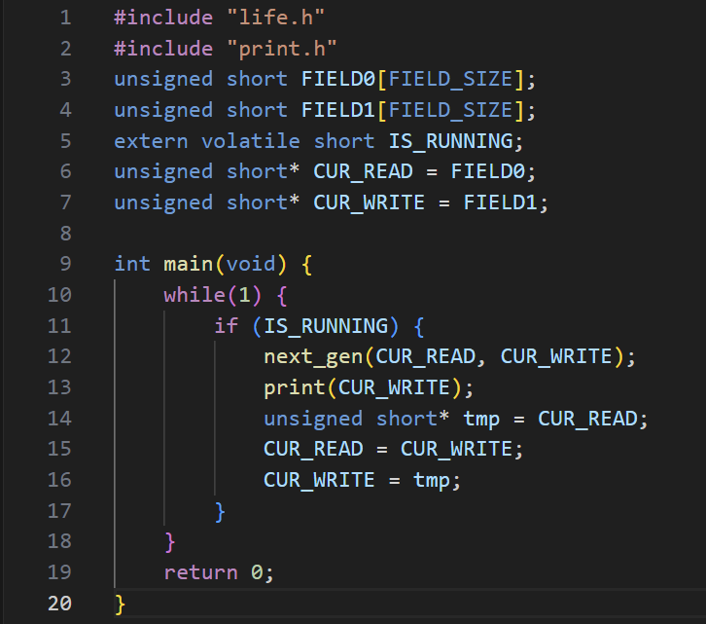
Source code files
1. main.c, while(1) cycle

Slide 11
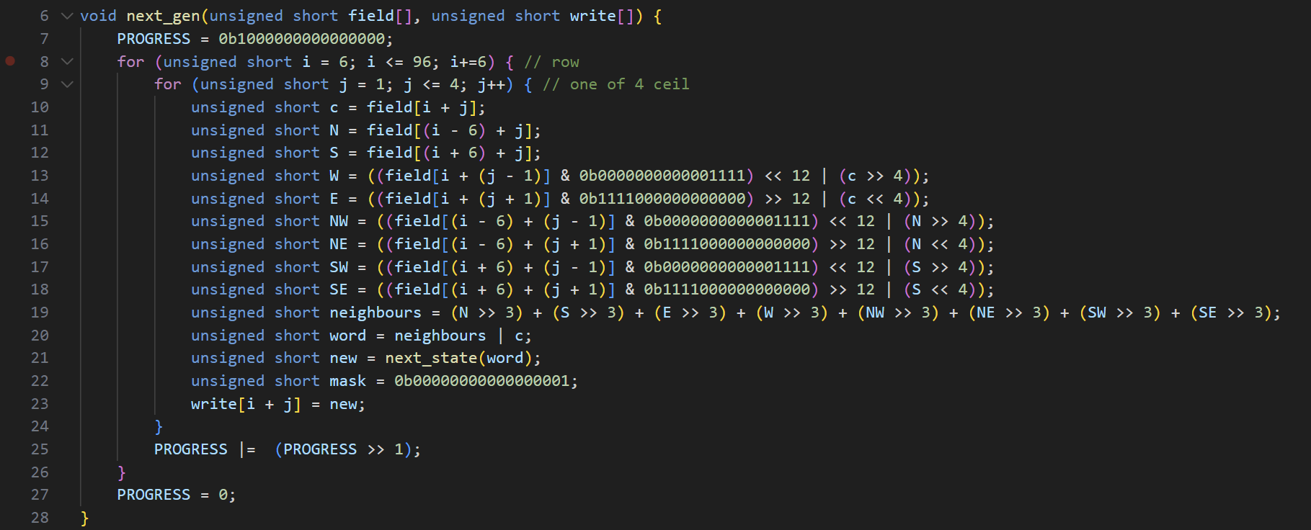
2. life.c, next_gen() function

Slide 12
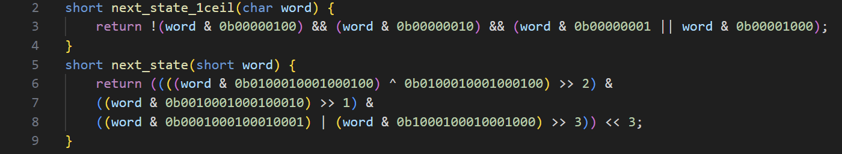
3. conclusion.c, next_state() function

Slide 13
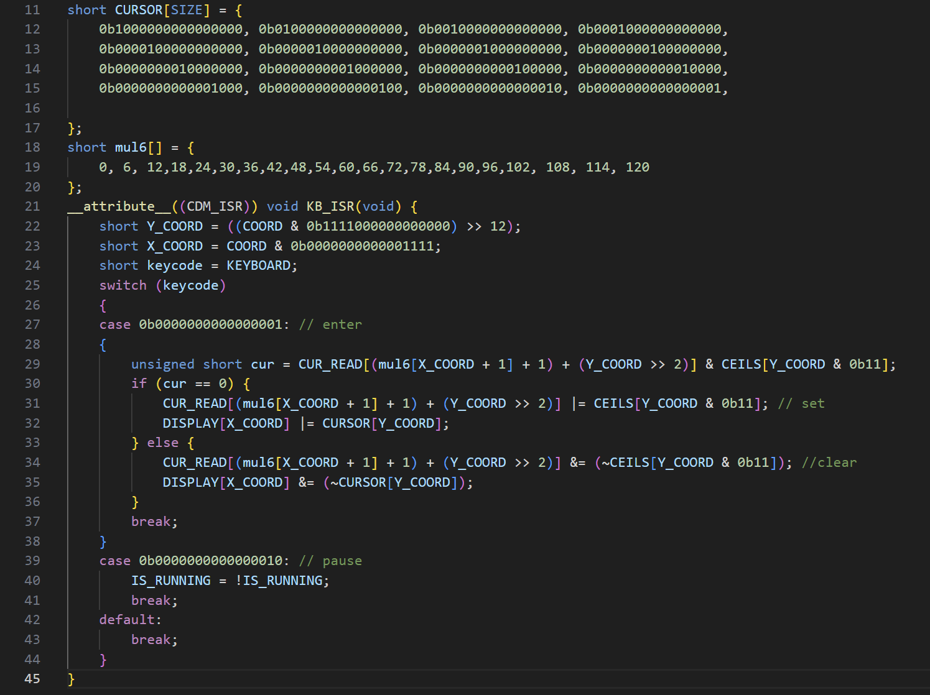
4. interrupts.c, KB_ISR()

Slide 14
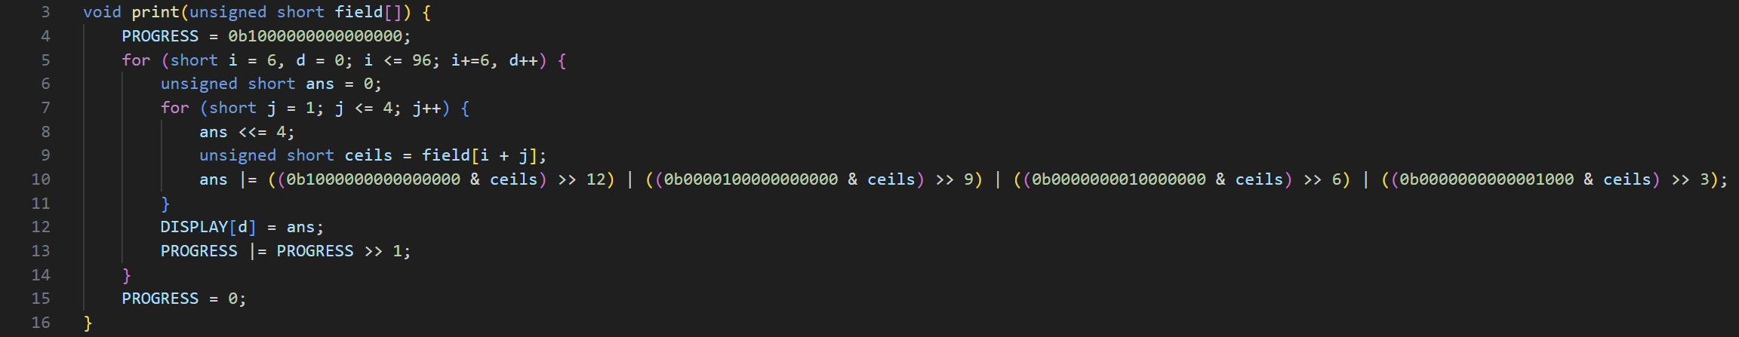
5. print.c, print() function

Slide 15
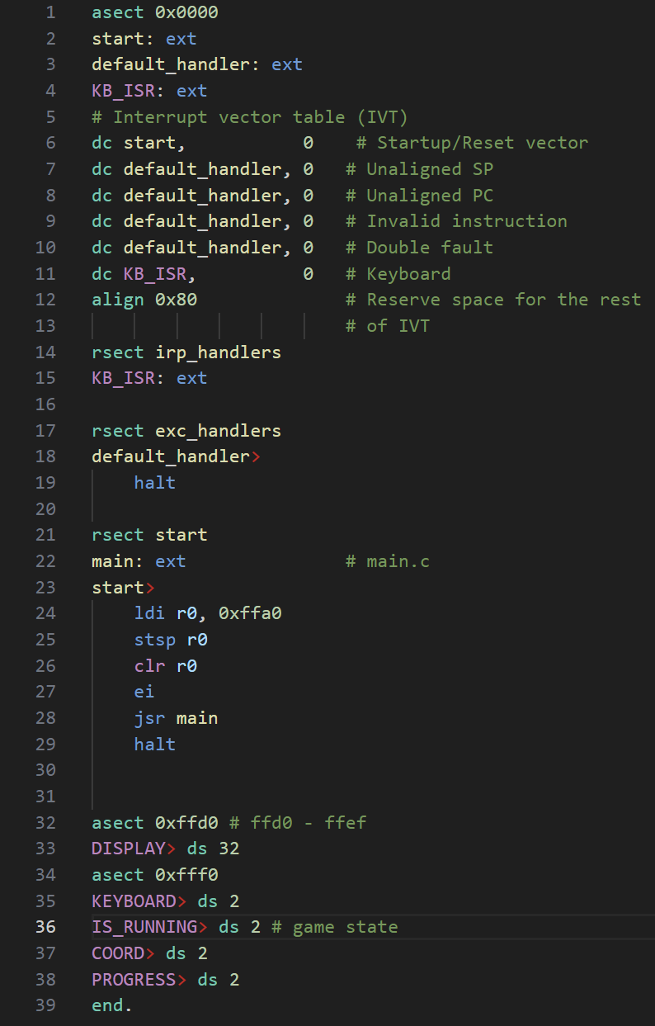
6. start.asm

Slide 16
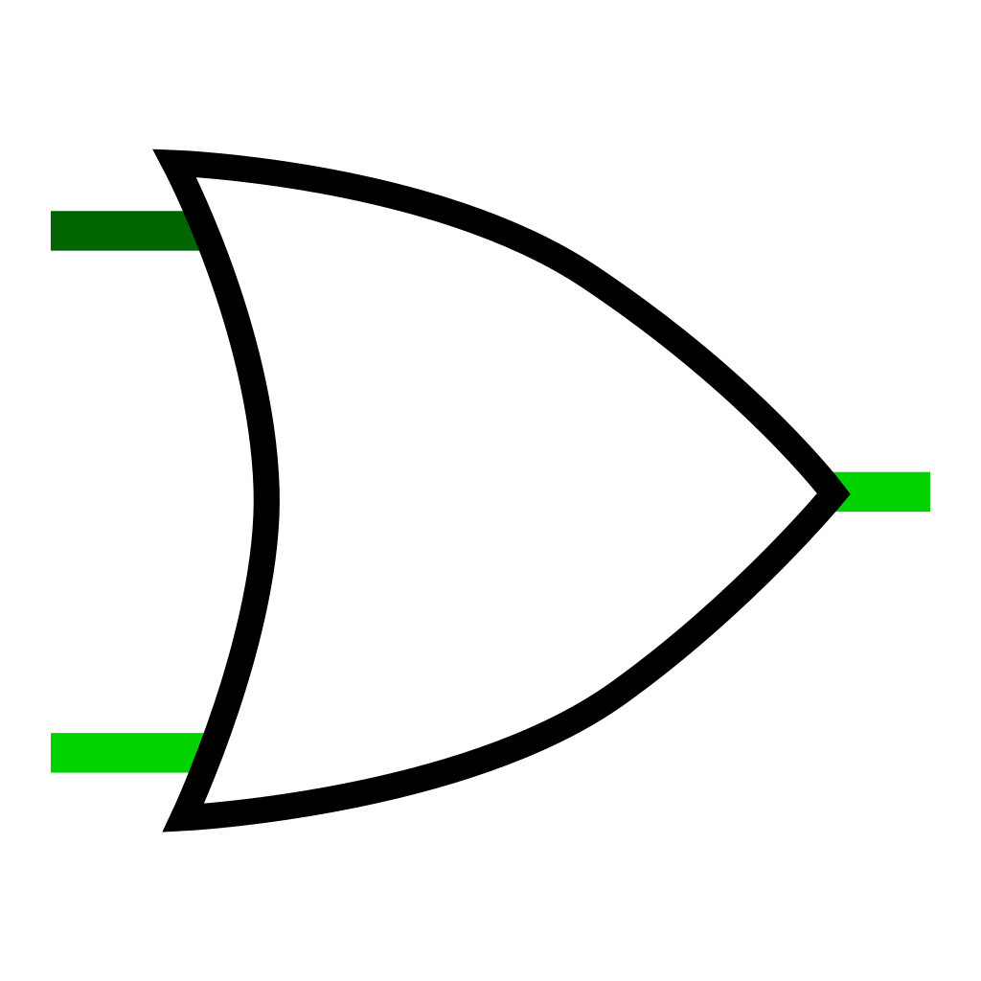
Hardware

Slide 17
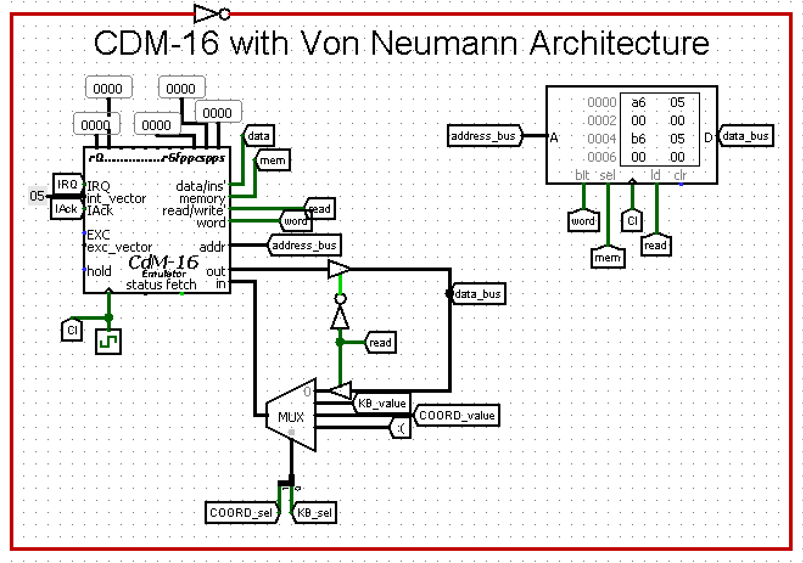
1. CDM-16 with Von Neumann Architecture

Slide 18
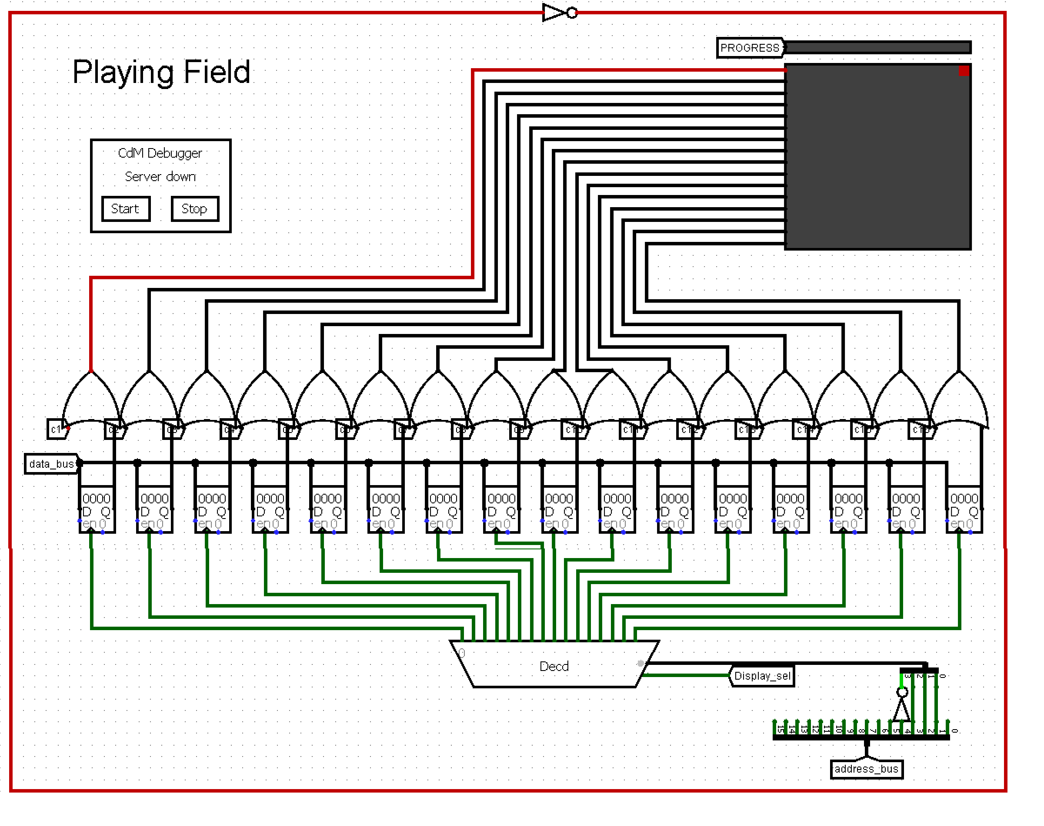
2. Playing Field

Slide 19
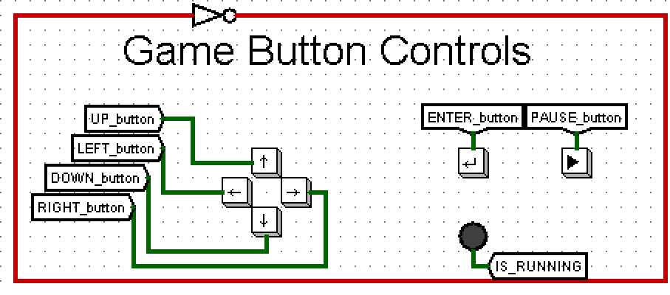
3. Game Buttons Controls

Slide 20
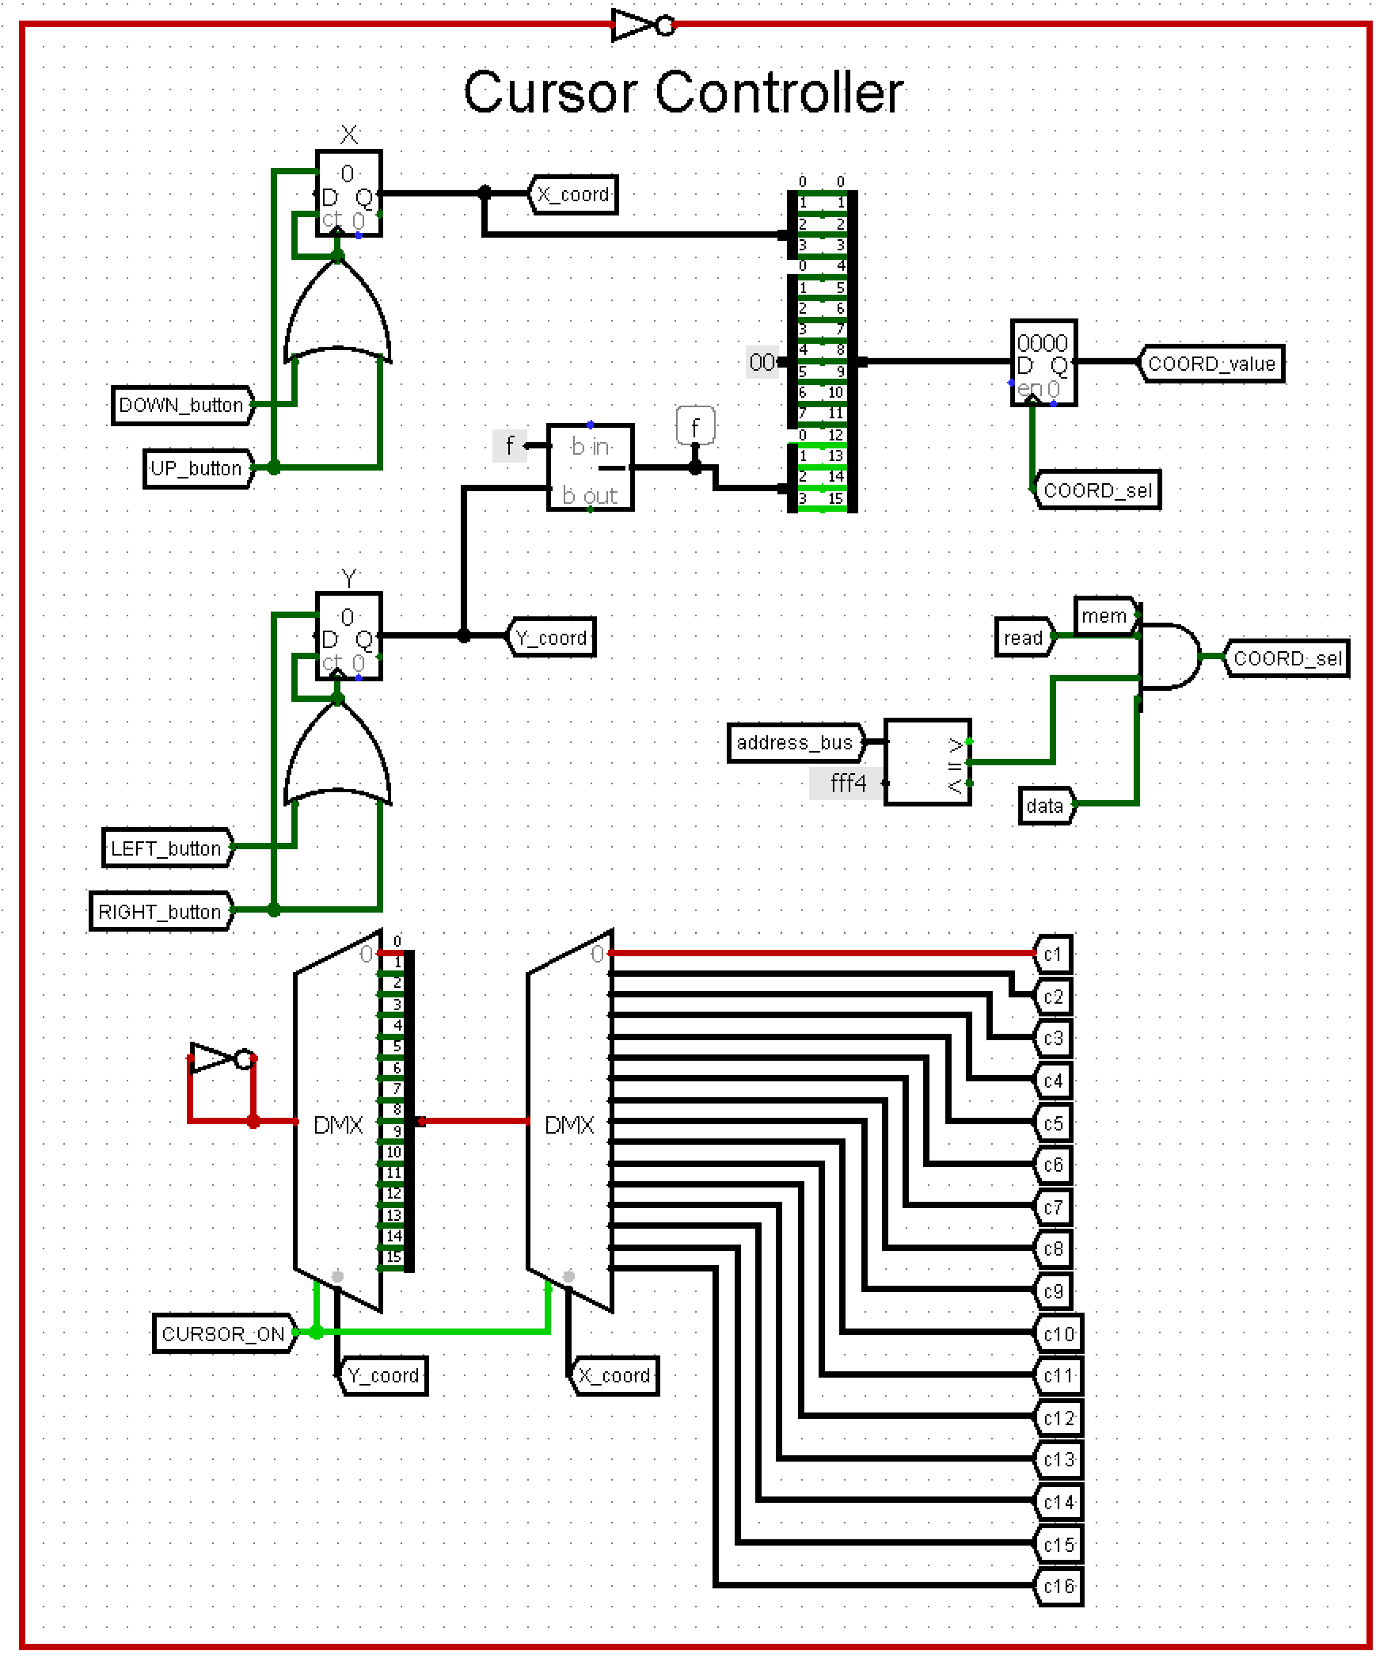
4. Cursor Controller

Slide 21
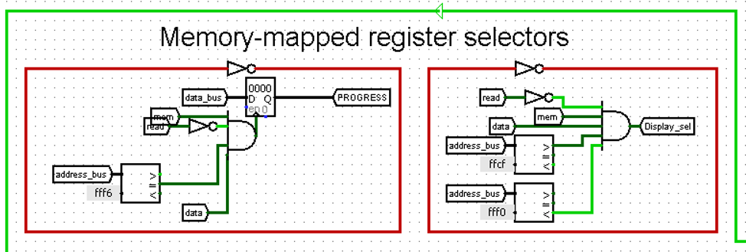
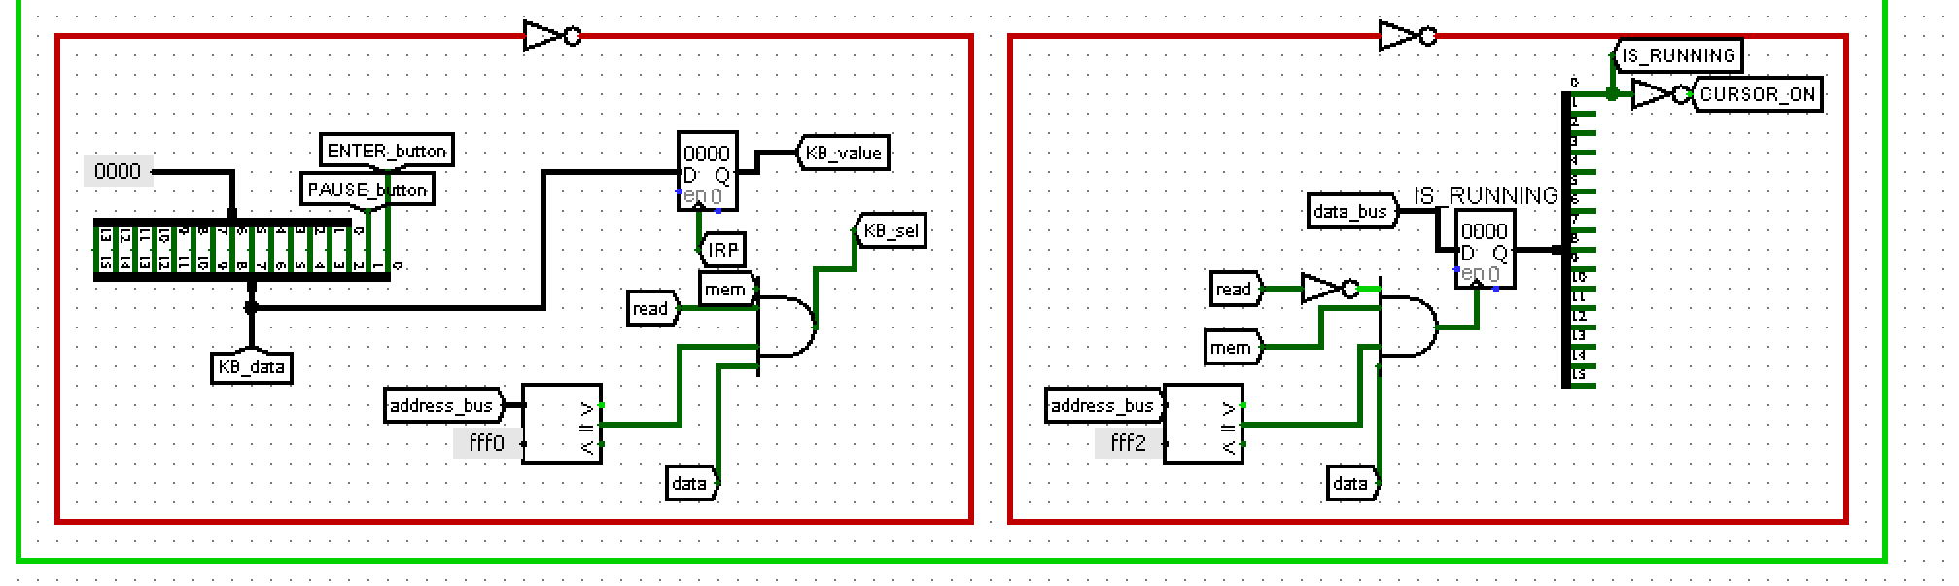
5. Memory-mapped register selectors

Slide 22
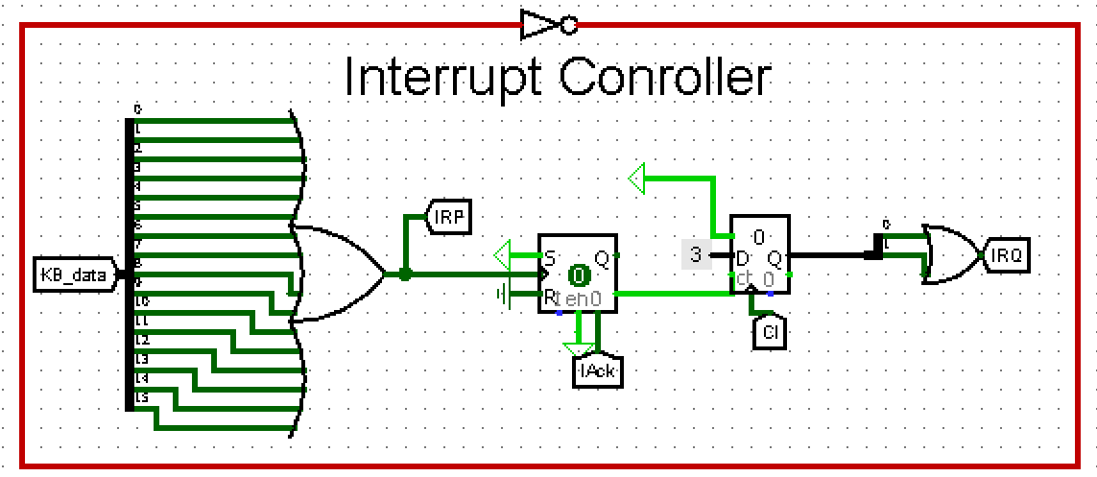
6. Interrupt Controller

Slide 23
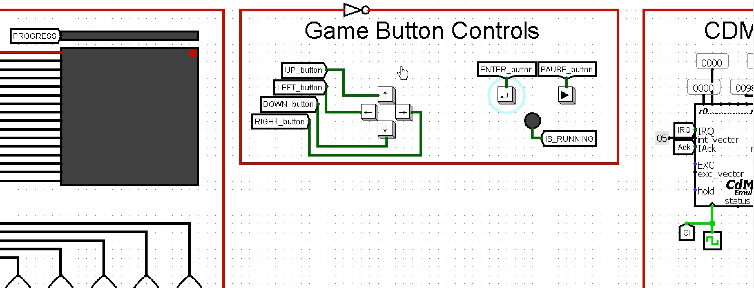
The result of our work (speed up 4x)

